Slide 1

6
CHAPTER
Input and Output
Notes:
Why are some computers more powerful than others?
Speed
Capacity
Flexibility
Competent end users need to understand the functionality of the basic components in the
System unit
The system board
Microprocessor
Memory
System clock
Expansion slots and cards
Bus lines
Ports, cables, and power supply units

Slide 2

Learning Outcomes(1/2)
Define input.
Describe keyboard entry including types and features of keyboards.
Identify different pointing devices including game controllers and styluses.
Describe scanning devices including optical scanners, RFID readers and recognition devices.
Recognize image capturing devices and audio-input devices.

Slide 3
Learning Outcomes(2/2)
6-<number>
Define output.
Identify different monitor features and types including flat-panels and e-books.
Define printing features and types including inkjet and cloud printers.
Recognize different audio and video devices including Bluetooth technology.
Define combination input and output devices including multifunctional devices, Internet telephones, and VR headgear and gloves.
Explain ergonomics and ways to minimize physical damage.

Slide 4

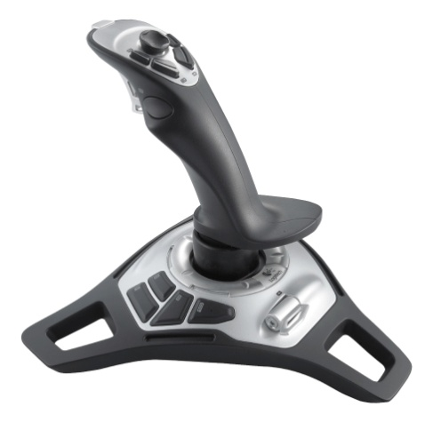

What is Input?
7-<number>
Any data or instructions used by a computer
Input devices
  Hardware
    Keyboards
    Mice
    Pointing devices
    Scanning devices
    Image capturing devices
    Audio-input devices
Input Devices Translate data into a form that the system unit can process
Notes:
Input devices are hardware used to translate words, sounds, images, and actions that people understand into a form that the computer can understand
Input allows user to put their information into computer language
Most common are keyboard, mouse, “light” pens, and increasingly voice!

Slide 5

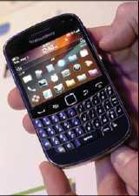
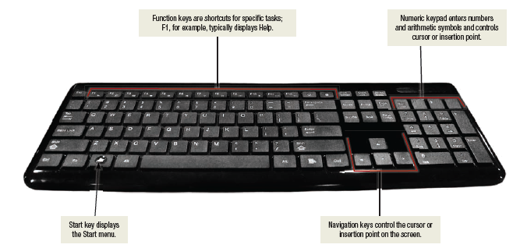
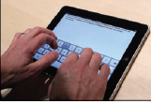
Keyboard Entry
Keyboards
  Traditional keyboards
  Laptop keyboards
  Virtual keyboards
  Thumb keyboards
Laptop keyboard
Virtual keyboard
Thumb keyboard
Notes:
Keyboards (key term) come in a variety of designs – most common way to input data
Range from full-sized to miniature and from rigid to flexible
Common types
Traditional keyboard (key term) – full sized, rigid, rectangular keyboards that include function, navigational, and numeric keys
Laptop keyboard (key term) – used on laptop computers
Virtual keyboard (key term) – keyboard for a tablet PC and mobile devices– shown on a touch screen
Thumb keyboard (key term) – used on smartphones

Slide 6
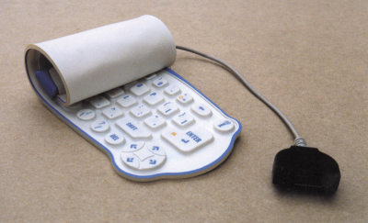
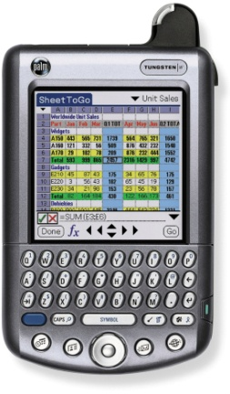
Keyboard Entry
7-<number>
Keyboards
  Traditional keyboards
    Flexible keyboards
    Ergonomic keyboards
    Wireless keyboards
    PDA keyboards
  Features
    Typewriter keyboard with numeric pad
    Special purpose keys
    Toggle(切换) and combination keys
Notes:
Keyboards come in a variety of designs
Range from full-sized to miniature and from rigid to flexible
Common types
Traditional
Flexible – fold or roll up fore easy packing or storage
Ergonomic keyboards – similar to traditional
Keyboard arrangement is not rectangular and a palm rest is provided
Wireless
PDA - miniature keyboards

Slide 7
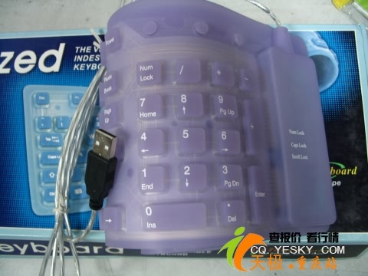
Flexible keyboards
7-<number>

Slide 8
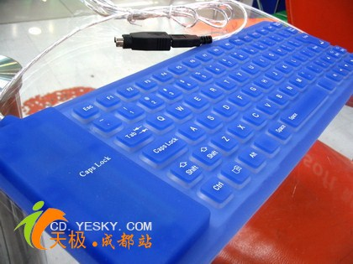
7-<number>

Slide 9
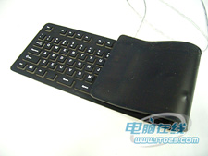
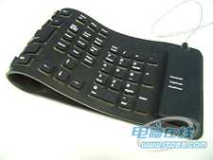
7-<number>

Slide 10
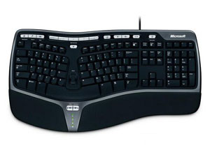
Ergonomic keyboards
7-<number>

Slide 11
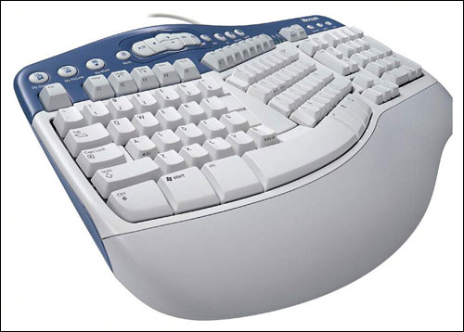
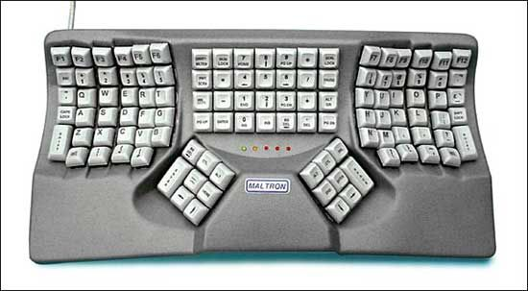
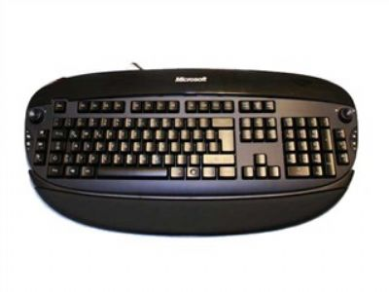
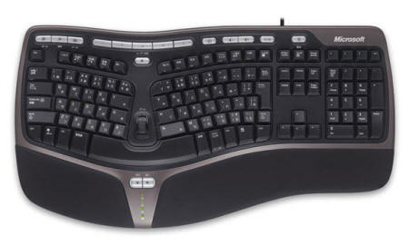
7-<number>

Slide 12
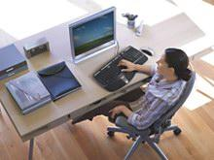
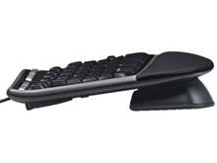
7-<number>

Slide 13
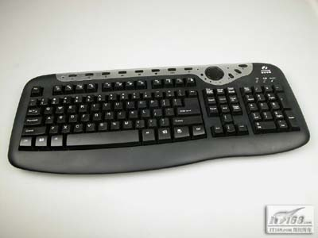
Wireless keyboards
7-<number>

Slide 14
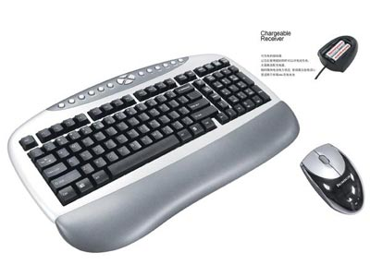
7-<number>

Slide 15
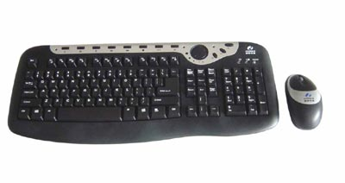
7-<number>

Slide 16
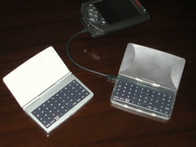
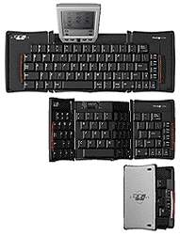
PDA Keyboard
7-<number>

Slide 17
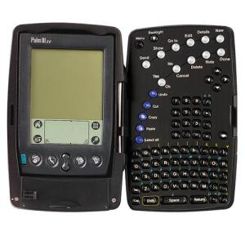
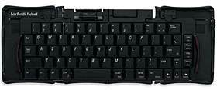
7-<number>

Slide 18
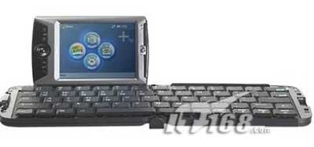
7-<number>

Slide 19
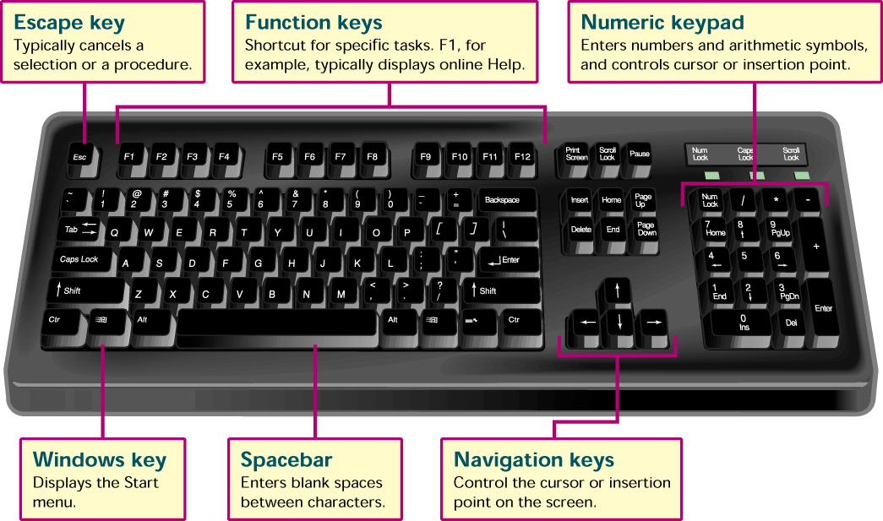
Traditional Keyboard
7-<number>
Notes:
Features
Numeric key pad – used to enter numbers and arithmetic symbols
Toggle keys
Cap Locks
Combination keys – perform an action when used with other keys
CTRL key

Slide 20
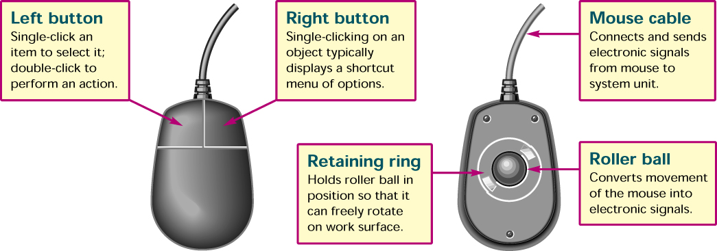
Pointing Devices
7-<number>
Mouse
  Mechanical
  Optical
  Cordless or wireless
Joystick
Touch Screen
Light Pen
Notes:
Direct entry creates machine-readable data that can go directly to the CPU.
Pointing devices mouse, joystick, touch screen, light pen and stylus
Mouse
Mechanical – traditional type
Optical – has no moving parts
Emits and senses light to detect mouse movement
Can be used on any surface
Cordless – battery powered
Uses radio waves or infrared light waves
Joystick – input for computer games
Touch Screen – a kind of monitor with a clear plastic outer layer
Easy to use
Commonly used at restaurants, ATMs, and information centers
Light pen – a light sensitive pen-like device

Slide 21
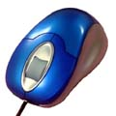
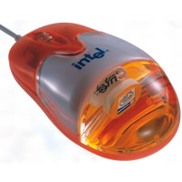
Optical Mouse
7-<number>

Slide 22
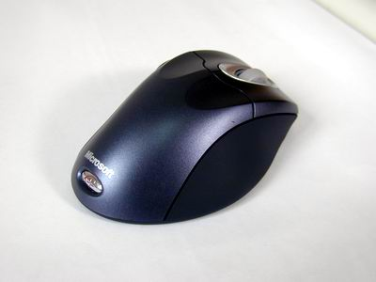
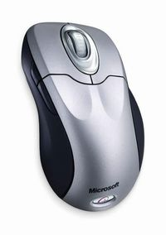
Cordless or wireless Mouse
7-<number>

Slide 23
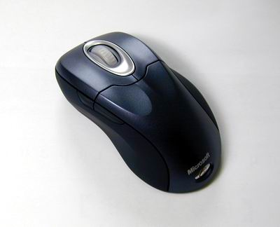
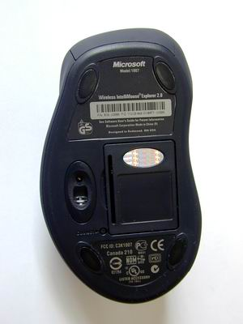
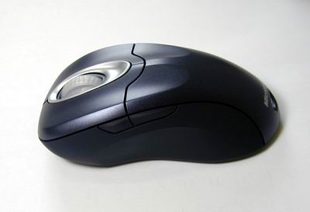
7-<number>

Slide 24
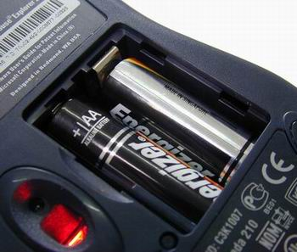
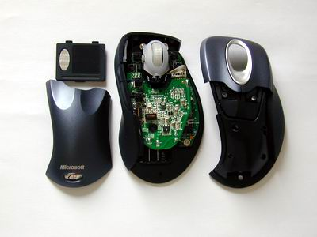
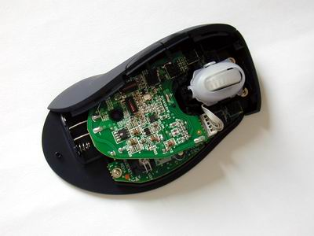
7-<number>

Slide 25
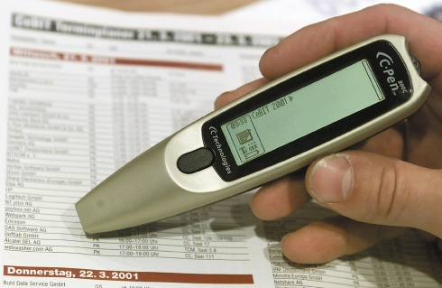
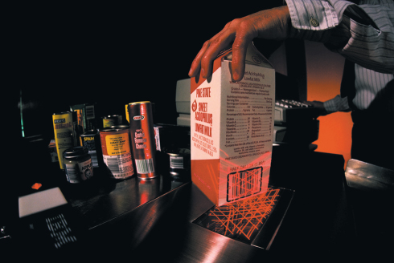
Scanning Devices
7-<number>
Optical scanners
  Flatbed
  Portable
Bar code readers
  Handheld wand readers or platform scanners
  Contain photoelectric cells that read bar codes
Notes:
Scanners move across text and images
Devices convert scanned data into a form the system unit can process
Types
Optical – known as a scanner
Recognizes light, dark, and colored areas that make up individual letters or images
Types
Flatbed
Portable
Bar Code Readers
You see these devices at the grocery store
Wand scanner or platform scanner
Reads bar codes or vertical zebra striped marks printed on product containers
Products have a UPC (Universal Product Code)

Slide 26
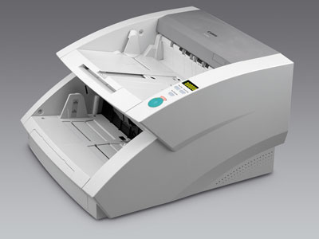

Optical scanners
7-<number>

Slide 27

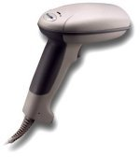


Bar code readers
7-<number>

Slide 28
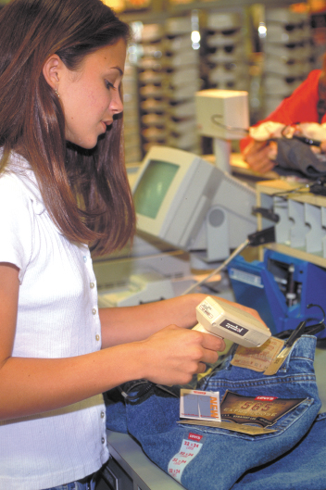
Scanning Devices
7-<number>
Character and mark recognition devices
Scanners that recognize special characters & marks
  Magnetic ink character recognition (MICR)
  Optical-character recognition (OCR)
  Optical-mark recognition (OMR)
Notes:
Character and mark recognition devices
MICR - used by banks to read magnetically encoded characters
OCR - specially preprinted characters are read by OCR devices such as wand scanners
OMR - devices sense the presence or absence of marks, common for test scoring

Slide 29
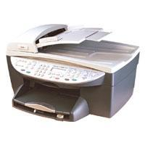
7-<number>
OCR（Optical Character Recognition，光学字符识别），是属于图型识别（Pattern Recognition，PR）的一门学问。电子设备（例如扫描仪或阅读器）检查纸上打印的字符，通过检测暗、亮的模式确定其形状，然后用字符识别方法将形状翻译成计算机文字的过程。

Slide 30
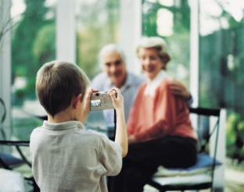
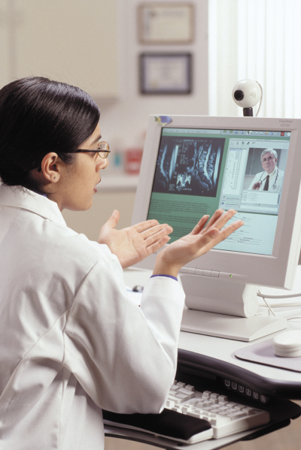
Image Capturing Devices
7-<number>
Digital camera
  Images recorded digitally on a disk
  Images can be downloaded to a computer
Digital video camera
  Records motion digitally
  Can take still images as well
  WebCams
    Specialized digital video cameras
    Broadcast images over the Internet
Notes:
These devices create or capture original images
Digital camera – images downloaded to a computer
Digital video camera – records motion digitally on a disk
Can take still photos as well

Slide 31
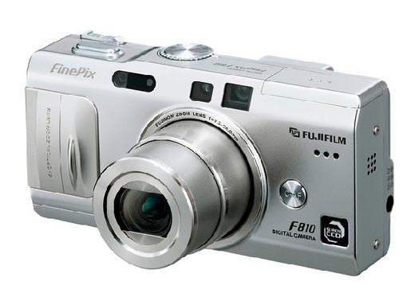
Digital camera
7-<number>

Slide 32
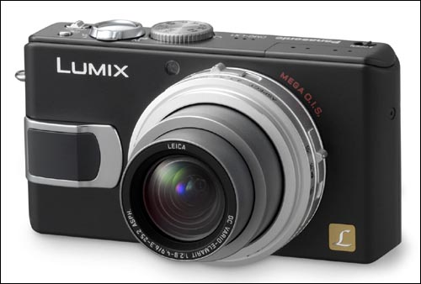
7-<number>

Slide 33
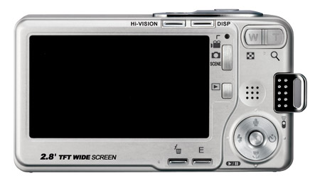
7-<number>

Slide 34
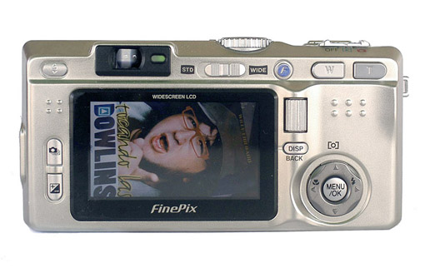
7-<number>

Slide 35
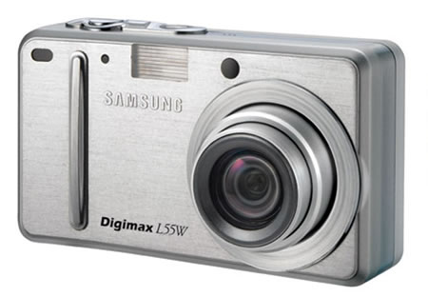
7-<number>

Slide 36

Digital video camera
7-<number>

Slide 37

7-<number>

Slide 38

7-<number>

Slide 39
WebCam
7-<number>
WEBCAM(网络摄象机), also called WEB CAMERA or IP CAM，IP CAMERA
Combine the function of traditional camera and vidio camera
Transmit video and image by network
Monitor image or video by Browser ,for example Microsoft IE ,Netscape

Slide 40




7-<number>

Slide 41



7-<number>

Slide 42

Digitizing Devices
7-<number>
Graphics Tablets
Digital Notepads
Notes:
Graphics tablets record sketches and tracings of maps and other drawings
Used by artist, mapmakers, and engineers
Digital notepads record handwritten notes and drawings
Similar to table PCs except that they typically use regular notepads and pens
Notepad is positioned on top of an electronic pad or tablet
Notes can later be processed, edited, and used with a word processing program

Slide 43





Graphics Tablets
7-<number>

Slide 44


Audio Input Devices
7-<number>
Voice
  Voice recognition systems
    Discrete-speech recognition systems
    Continuous-speech recognition system
  Music
    Musical Interface Digital Interface (MIDI)
Notes:
Convert speech into digital code; most common device is the microphone
Voice recognition systems
Microphone, bundled with sound card and software
Some voice recognition systems must be trained for user’s voice
Some can translate from one language to another
Types
Continuous speech - used to issue commands to special application programs
Two well known systems
Naturally-Speaking from Dragon Systems
ViaVoice from IBM
Discrete-word – able to recognize individual words based on their sound
Cannot distinguish between same-sound words such as there, their
MIDI – standard that allows musical instruments to connect to the system unit using MIDI ports

Slide 45

7-<number>
MIDI系统实际就是一个作曲、配器、电子模拟的演奏系统。从一个MIDI设备转送到另一个MIDI设备上去的数据就是MIDI信息。MIDI数据不是数字的音频波形，而是音乐代码或称电子乐谱。

Slide 46


What is Output?
7-<number>
Processed data or information
Types of output
  Text
  Graphics
  Audio & video
Output devices
  Monitors
  Printers
  Other Devices
Notes:
Converts machine-readable information into people-readable form
Four most common output devices used with microcomputers – text, graphics, audio, and video
Monitors are commonly called display screens

Slide 47


Monitors
7-<number>
Known as screens or display screens
Output referred to as soft copy
Features
  Resolution
  Dot pitch
  Refresh rate
  Size
Notes:
Standards indicate screen quality (resolution). Some monitors are used on the desktop, others are portable.
Features
Resolution – expressed as a series of dots or pixels
Dot pitch – the distance between each pixel
Refresh rate – indicates how often a displayed image is updated or redrawn on the monitor
Size – is measured by the diagonal length of a monitor’s viewing area
Common sizes are 15, 17, 19, and 21 inches

Slide 48
Homework
7-<number>
How we can judge a monitor is good?

Slide 49


More on Monitors
7-<number>
Cathode-ray tube or CRTs
Flat-panel
  Liquid crystal display (LCD)
  Require less power to operate
  Portable and thinner than CRTs
Other monitors
  E-books
  Data projectors
  High-definition television (HDTV)
Notes:
Cathode-Ray Tubes - similar to television technology
Flat-Panel Monitors - or liquid display (LCD) monitors
Passive-matrix or dual-scan - images created by scanning the entire screen
Active-matrix - each pixel is individually activated
eBook – hand-held, book sized; cost less than publishing and delivery of printed matter
Data projectors – similar to slide projectors; extension of monitor
HDTV – merger of microcomputer and TV; not taking off as much as developers had hoped; what is cost? What is availability? How many in classroom are participating?

Slide 50

Printers
7-<number>
Translates information that has been processed by the system unit
Output referred to as hard copy
Features
  Resolution（dpi）
  Color capability
  Speed
  Memory
Notes:
Printers translate information that has been processed by the system unit and present the information on paper
Output is called hard copy
Features
Resolution – measures the clarity of images produced
Measured in dpi (dots per inch)
Most printers use an average of 1200 dpi
Color – more expensive to print in color
Speed – measured in the number of pages printed per minute
10-15 pages per minute is the average for a single color page; 5 to 10 pages per minute for color
Memory – used to store printing instructions and documents waiting to be printed

Slide 51

Printers
7-<number>
Ink-jet printer
Laser printer
  Personal laser printers
  Shared laser printers
Thermal printer
Other printers
  Dot-matrix
  Plotters
  Photo printers
Notes:
Three major types of printers: ink-jet, laser and thermal; most people are familiar with these
Inkjet printers spray ink at high speed onto the surface of paper
Laser printers uses a laser light beam to produce images
More expensive than ink jet printers
Thermal printers – uses heat elements to produce images on heat sensitive paper
Used to produce high quality art work
Other Printers
Dot-matrix – slow and not used much any more; poor quality but faster than some of newer printers
Very noisy
Inexpensive
Photo printers – designed to print photographs from digital cameras
Plotters – special purpose for maps, images, architectural & engineering drawings

Slide 52

Ink-jet printer
7-<number>

Slide 53


7-<number>

Slide 54

Laser printer
7-<number>

Slide 55

7-<number>

Slide 56

7-<number>

Slide 57



Plotters
7-<number>

Slide 58



Photo printers
7-<number>

Slide 59


7-<number>

Slide 60

Audio-Output Devices
7-<number>
Translates audio information from the computer into sounds that people can understand
Common devices
  Speakers
  Headphones
Digital Music Players
  iPod
  iRiver
Page 203
Notes:
These devices produce sounds for people
Connected to a sound card in the system unit
Voice output is quite common; creating voice output is not as difficult as recognizing and interpreting voice input
Digital Music Players (also called digital media players (Key Term)) are specialized devices for storing, transferring, and playing audio files. Older players play MP3 files only. Newer players recognize other formats and also video.

Slide 61




7-<number>

Slide 62





7-<number>

Slide 63

Combination Input and Output Devices
7-<number>
Fax machines
Multifunction devices
Internet telephones
  known as Internet telephony
  IP telephony
  and Voice-over IP (VoIP)
  Three approaches
Terminals
Notes:
Combination devices include fax machines, multifunction devices, Internet telephones, and terminals
Internet telephone – specialized input and output devices for receiving and sending voice communication
Connect to the system unit through a USB port
Telephony – the transmission of telephone calls over computer networks
Known as Voice over IP
Uses Internet rather than traditional
Requires
Internet telephone
Internet
Special service provider
Sound card
Special software
Terminal is an input and output device that connects to a mainframe or a host computer

Slide 64
Internet Telephone Approaches
7-<number>
Computer-to computer
  Free long distance calls
  Requires computers to be connected to the Internet
  MSN is most widely used software
Computer-to traditional telephone
  Place the call from a computer to a phone
  Requires an Internet phone service provider
    Software requirements
    Small monthly and/or per-minute fee
Traditional telephone-to-traditional telephone
  Does not require a computer
  Subscription required to a special Internet phone service provider
    Special hardware adapter
    Cost is similar to the computer-to-traditional telephone approach
Page 215
Notes:
Computer-to computer
Place free phone calls when using a computer to send and also to receive via the Internet
Software is available for free or very low cost
Computer-to traditional telephone
Place the call from a computer to a phone using an Internet phone service provider that supplies the software for a small monthly fee and/or airtime fee
Traditional telephone-to-traditional telephone
Subscription to an Internet phone service provider that supplies a special hardware adapter to connect a traditional phone to the Internet with a fee connected to service

Slide 65




Fax machines
7-<number>

Slide 66

Multifunction devices
7-<number>

Slide 67

7-<number>

Slide 68

7-<number>
  IP telephony

Slide 69

7-<number>

Slide 70

Terminals
7-<number>
An input and output device
Connects to a mainframe or server
Types of terminals
  Dumb terminal
  Intelligent terminal
  Network terminal
Notes:
Terminals - input and output device connecting users to mainframe computers
Dumb terminal - no processor or local storage
Intelligent terminal - CPU, memory and storage; Net PC, or network computer
Network terminal - low cost alternative to intelligent terminal
Internet terminal - or Web terminal, accesses and displays Web pages on a television set

Slide 71
Dumb Terminal
7-<number>
A dumb terminal in computing consists of a computer screen and keyboard, but practically no processing ability. They allow a user to carry out work on a remote server, minicomputer or mainframe. They have largely been superseded by personal computers.
Dumb terminals are display and input devices which don't process data and input locally, instead transmitting input to a computer to which it is connected and displaying the resulting output.

Slide 72


Intelligence Terminal
7-<number>

Slide 73



7-<number>

Slide 74



7-<number>

Slide 75

Virtual Reality
Virtual Reality
  Headgear
  Gloves
Notes:
Virtual Reality (key term) – simulated reality created in 3-d through computers. Creates a virtual or (immersive experience)
Headgear (key term) and gloves (key term) have sensors to collect data that work with software

Slide 76

Ergonomics
Study of human factors related to things people use
Fit the task to the user to avoid:
  Eyestrain and headache
  Back and neck pain
  Repetitive strain injury
Notes:
Ergonomics (key term) – fitting the task to the user
Study to avoid :
Eyestrain (key term) and headache (key term) – 15 minute break every hour
Back and neck pain (key term) – equipment should be adjustable
Repetitive strain injury (key term) RSI (key term) – injury caused by repetitive injury
Carpal tunnel syndrome (Key term) – damage to nerves and tendons in hands

Slide 77


Ergonomics (Cont.)
Portable Computers
  Not set up for Ergonomics
    Laptops
    Tablets
      Tablet Hunch
    Smartphones
      Blackberry thumb
Notes:
Portable devices are not set up for ergonomics
Study to avoid :
Laptops – raise the level of the screen with books or reams of paper or connect an external keyboard
Tablets – avoid tablet hunch by taking frequent breaks or using a stand or external keyboard
Smartphones – avoid blackberry thumb by keeping wrists straight, head up and shoulders straight.

Slide 78
Discussion Questions (Page 1 of 2)
7-<number>
Define input and input devices.
Describe the different types of pointing, scanning, image capturing, and audio-input devices.
Describe the three categories of output devices.
Page 214
Notes:
Have students turn to the end of Chapter 7 in their textbooks to view the same “Open-Ended” questions/statements

Slide 79
Discussion Questions (Page 2 of 2)
7-<number>
Define output and output devices.
What are combination input and output devices? Describe four such devices.
Page 214
Notes:
Have students turn to the end of Chapter 7 in their textbooks to view the same “Open-Ended” questions/statements

Slide 80
Exercise
2-<number>
Page 166: Multiple Choice
Page 167: Matching
Page 167: Open-ended
Page 82
Notes:
A collection of separate applications bundled and sold as a group that share information between applications
Less expensive than individual applications; but more expensive than integrated packages
Personal suites contain personal software (Key Term) applications intended for home use

